Slide 1

Introduction to JAVA
Lecture - 1
Tokey Ahmmed
Lecturer, Dept. of CSE Varendra University tokey@vu.edu.bd

Slide 2
Content
About Java Technology
As Programming Language
As Platform
Java Editions
Java Environments
Java Compilation Process
2

Slide 3
About Java Technology
Java is both a
programming language and
platform.
3

Slide 4
Java as Programming Language
The Java programming language is a high-level language that can be characterized by all of the following buzzwords:
Simple
Object oriented
Distributed
Multithreaded
Dynamic
Architecture neutral
Portable
High performance
Robust
Secure
* Each of the preceding buzzwords is explained in The Java Language Environment , a white paper written by James Gosling and Henry McGilton.
4

Slide 5
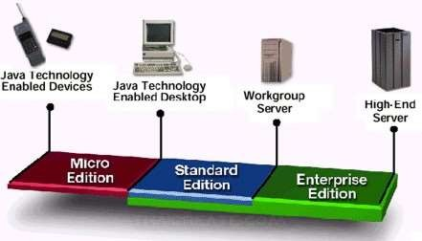
Java as Platform
A Platform is the hardware or software environment in which a program runs.
The Java platform is a software-only platform that runs on top of other hardware-
based platforms.
*** As a platform-independent environment, the Java platform can be a bit slower than native code. However, advances in compiler and virtual machine technologies are bringing performance close to that of native code without threatening portability.
5

Slide 6
What Can Java Technology Do (Just Skim)
The general-purpose, high-level Java programming language is a powerful software platform. Every full implementation of the Java platform gives you the following features:
Development Tools: The development tools provide everything you'll need for compiling,
running, monitoring, debugging, and documenting your applications. As a new developer, the main tools
you'll be using are the javac compiler, the java launcher, and the javadoc documentation tool.
Application Programming Interface (API): The API provides the core functionality of the
Java programming language. It offers a wide array of useful classes ready for use in your own applications. It
spans everything from basic objects, to networking and security, to XML generation and database access,
and more. The core API is very large; to get an overview of what it contains, consult the Java Platform
Standard Edition 8 Documentation.
Deployment Technologies: The JDK software provides standard mechanisms such as the Java
Web Start software and Java Plug-In software for deploying your applications to end users.
User Interface Toolkits: The JavaFX, Swing, and Java 2D toolkits make it possible to create
sophisticated Graphical User Interfaces (GUIs).
Integration Libraries: Integration libraries such as the Java IDL API, JDBC API, Java Naming and
Directory Interface (JNDI) API, Java RMI, and Java Remote Method Invocation over Internet Inter-ORB
Protocol Technology (Java RMI-IIOP Technology) enable database access and manipulation of remote
objects.
7

Slide 7
Java Editions
Standard Edition (Java SE)
Enterprise Edition (Java EE)
Micro Edition (Java ME)
8

Slide 8
Java Standard Editions
Till now ^{(18 Jan, 2021)} Java has 15 versions of standard editions^{[1]}
Standard Edition (Java SE) | Enterprise Edition (Java EE) | Micro Edition (Java ME)
J2SE 1.2
J2SE 1.3
J2SE 1.4
J2SE 5.0
Java SE 6
Java SE 7
Java SE 8 (LTS) Java SE 9 | Not Covering | Not Covering
Java SE 10
Java SE 11 (LTS)
Java SE 12
Java SE 13
Java SE 14
Java SE 15
[1] - https://en.wikipedia.org/wiki/Java_version_history
9

Slide 9
Java Environments
JRE
JVM

Slide 10
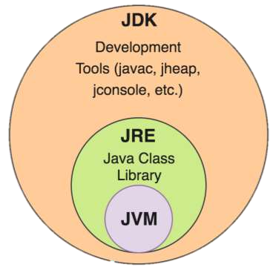
Java Environments
Oracle has 2 products that implement Java SE:
Java Runtime Environment (JRE) and
An installation package It physically exists Provides environment
to only run (not develop)
Part of the JDK
It contains a set of libraries
+ other files that JVM uses at runtime
Java Development Kit (JDK)
A software package
To create Java-based applications Provides the environment to develop
and execute(run) the Java program
Includes two things
Development Tools (such as Java compiler) JRE (Executes java program)

Slide 11
Java Virtual Machine (JVM)
Java Virtual Machine (JVM) is a engine that provides runtime environment to drive the Java Code or applications.
Java Virtual Machine (JVM)
An abstract machine
It is called a virtual machine because it doesn't physically exist
Part of both JDK and JRE
JVM is responsible for executing the java program line by line
It is the heart of the Java technology.

Slide 12
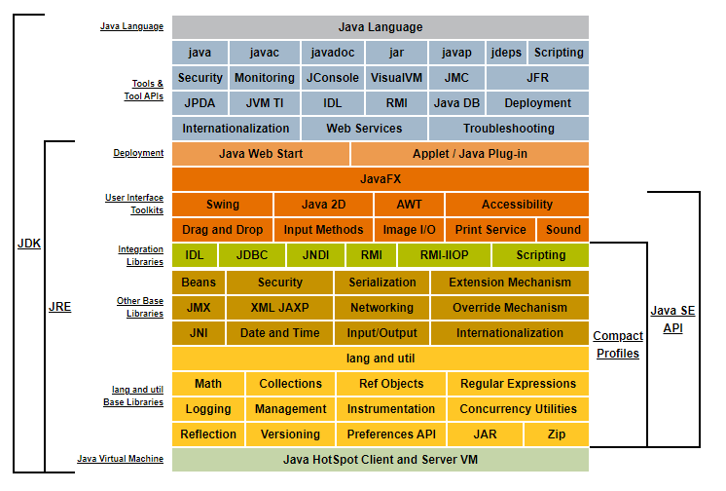
Java Conceptual Diagram (of Java SE 8)
Source: https://docs.or acle.com/javas e/8/docs/index. html

Slide 13
Java Compilation Process

Slide 14
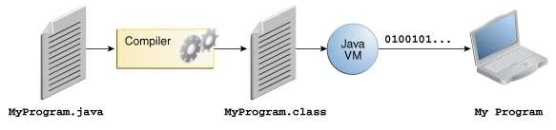
Java code Compilation Process
In the Java programming language, all source code is first written in plain text files ending with the .java
extension.
Those source files are then compiled into .class files by the javac compiler.
A .class file does not contain code that is native to your processor; it instead contains bytecodes - the machine language of the Java Virtual Machine (JVM).
The java launcher tool then runs your application with an instance of the Java Virtual Machine.

Slide 15
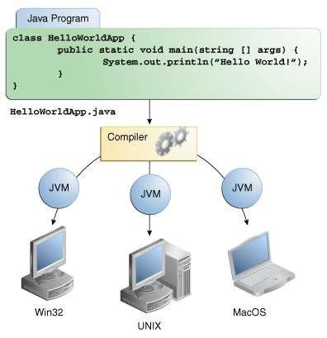
Java’s Platform Independency
Because of JVM, Java is supported on many different operating systems.
So the same .class files are capable of running on different operating systems.
such as:
Microsoft Windows,
The Solaris™ Operating System (Solaris OS),
Linux or
Mac OS.

